Slide 1
Navigating the Open Access Landscape
Ali Krzton, Research Data Management Librarian
10/25/17

Slide 2
What is Open Access?
The OA movement is about availability of information, specifically the products of research and scholarship
“Information is expensive” vs. “Information wants to be free”
No technical barriers to access beyond needing an internet connection
Notes:
The expensive/free formulation is derived from what Stewart Brand (MIT) said in 1984.

Slide 3
“The public good [the Internet] make[s] possible is the world-wide electronic distribution of the peer-reviewed journal literature and completely free and unrestricted access to it by all scientists, scholars, teachers, students, and other curious minds.”
  -From the Budapest Open Access Initiative original declaration (2002)
  Retrieved from http://www.budapestopenaccessinitiative.org/read

Slide 4
Traditional Scholarly Publishing
Conduct research
Article is published!
Submit to journal
Manuscript reviewed
Article accepted
Write article
Library subscribes
Users read
Notes:
Graphic adapted from Jaena Alabi (the final two panels were added for this presentation)

Slide 5
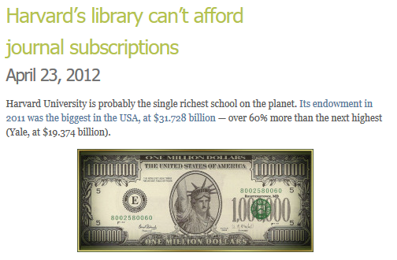
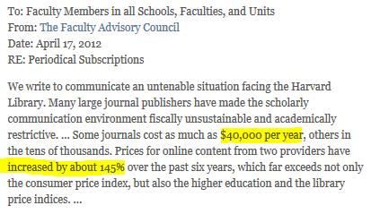
Subscriptions vs. budgets
Notes:
Source for images on this page: https://svpow.com/2012/04/23/harvards-library-cant-afford-journal-subscriptions/

Slide 6
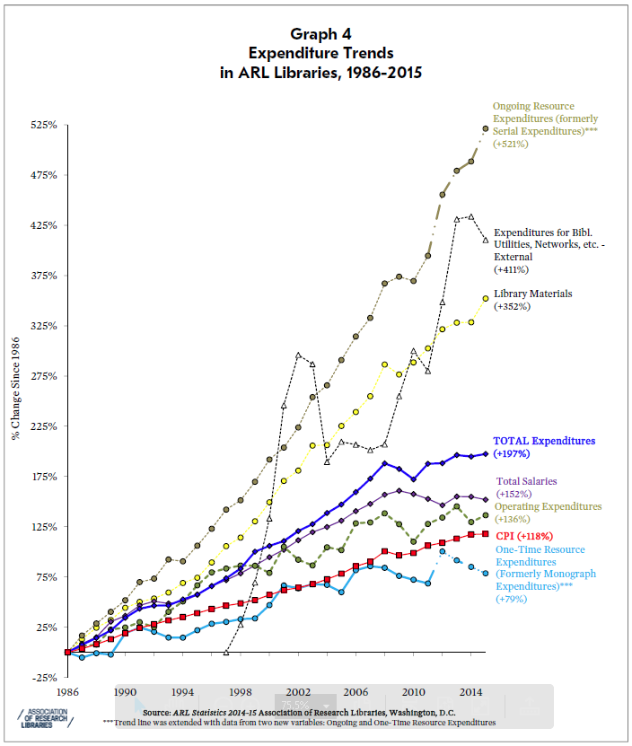

Slide 7
Two flavors of Open Access
Green: self-archiving of pre- or post-prints (and other items)
  -Examples: AUrora, subject repositories (arXiv)
Gold: author-pays model in regular journals
  -Examples: PLoS, BioMed Central
Tradeoffs – time vs. money

Slide 8
Benefits
Instant access for anyone, anywhere, any time (with Internet)
Visibility for the researcher
New integrations and analyses become possible
Better return on a public investment

Slide 9
Ongoing issues with Open Access
Hybrid journals – are publishers “double-dipping”?
Predatory journals – when legitimacy is in doubt
Quality assurance – the firehose problem

Slide 10

Author rights and control
Scholars are content creators
Traditional publishing stripped creator control
OA has spurred a renewed emphasis on author rights
OA + creator control can curb plagiarism/fraud
For more information: creativecommons.org

Slide 11
Discussion
Who are the relevant stakeholders in scholarship? How can we balance their rights? Who is getting left out?
What are the barriers to OA uptake among authors?
Should funders or journals mandate OA?
What does positive change look like?

