Slide 1
Piloting a Digitization Workflow for Analog Agricultural Data
Ali Krzton, Auburn University Libraries
RDAP Summit Lightning Talks 3/15/2022

Slide 2
The Problem: Our Cabinets Overfloweth
There is a tremendous backlog of data and supporting materials recorded on paper across major institutions
→ This problem is especially acute in agricultural research
Faculty retirements increase the pressure to decide the fate of physical files
Much irreplaceable data is at risk of loss

Slide 3
The Call: Plan for the Future
In 2021, the Department of Entomology and Plant Pathology asked AU Libraries for help with the files of two retired faculty
The department needs to develop robust procedures for archiving faculty materials as they retire, especially paper records
Ideally, procedures could be standardized within the entire College of Agriculture
→ There is particular interest in making data FAIR

Slide 4
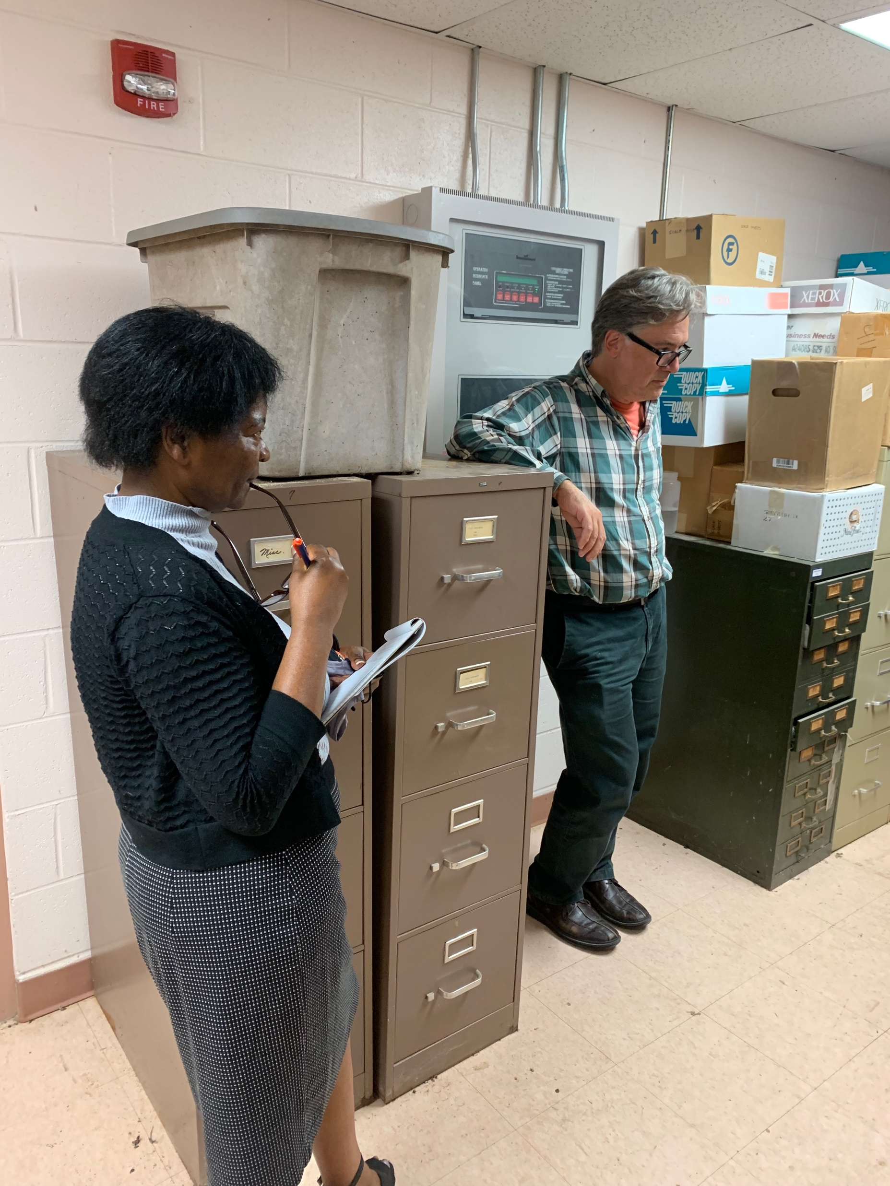
AU’s Agriculture Librarian Claudine Jenda (left) and Head of Special Collections and Archives Greg Schmidt (right) assess the collected files containing the work of two professors emeriti in Entomology and Plant Pathology. photo by Ali Krzton

Slide 5
Where Are We Now?
The entire collection of paper records for one professor emeritus is now housed within the Libraries’ Special Collections and Archives
Research librarians “borrowed” one unprocessed box to work on
The Agriculture Librarian, Biology Librarian, and Research Data Management Librarian reviewed the files it contained to determine the types of documents and data present
A student worker, supervised by the Ag and RDM librarians, identified duplicate information within the files and has begun digitizing the unique items

Slide 6
The Student Perspective
“I feel honored to assist in the effort of immortalizing research… The preservation of these collections through digitization will allow so many opportunities for past work to be implemented in current research. Otherwise, the data from these experiments would collect dust in a cabinet somewhere.
The skills required to do this [work] are…pattern recognition and basic technology skills, such as using a scanner. …[U]tilizing text reading software would be a great development as it would expedite the process. This project has so much potential to flourish into a full-scale digitization.”
—Courtney Stewart, undergraduate student assistant

Slide 7
Who’s Doing What?
WHO | WHAT
Department of EPP personnel | Identify at-risk data, provide context
Special Collections and Archives | Assess potential collections, physically transport and house paper records, ingest and process as archival materials
Research librarians | Find macro-level patterns within the collection, identify scholarly publications related to the data, bring subject knowledge to bear, make data FAIR
Student worker(s) | Learn the particulars of the collection, find micro-level patterns, digitize documents, enter data manually

Slide 8
What Comes Next?
→ Continue scanning the unique items in the files
→ Enter data tables in a machine-readable format
→ Decide how to make the digitized reports available
→ Repeat the process with the other boxes
→ Generalize procedures to other research collections

Slide 9
Thanks for listening!
Questions?
Ali Krzton, alk0043@auburn.edu

