Slide 1

Welcome to the Machine
Ir/Responsible Use of Machine Learning in
Research Recommendation Tools
Ali Krzton, Auburn University Libraries
ACRL 2023 Contributed Paper Presentation

Slide 2

Research Recommendations
Scholars are easily overwhelmed by the volume of sources
Information overload is now a “big data” problem
Can AI help researchers to tame the literature?

Slide 3
Machine Learning Basics
Machine learning is a type of AI technology
Operates by finding correlations between features
Process is not explicitly programmed
Machine learning can make new, surprising connections

Slide 4

Emergent Behavior
Q. How does a machine learning algorithm identify a picture of a cat?
A. The same way you do.

Slide 5
Exploring New Topics
Interdisciplinary research involves leveraging insights from multiple fields of study and potentially multiple methodologies
Searching in unfamiliar areas is especially challenging
Machine learning can help people jump in faster
Potential to identify novel connections in the literature

Slide 6
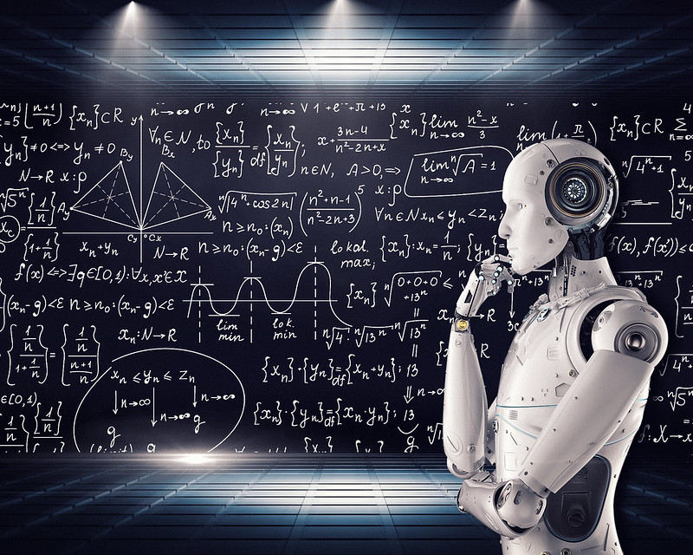
It’s About the Data
What is the source of the data used to train the ML model?
Two general categories:
Literature-based (or text-based)
User behavior-based (or based on user profiles)
"Artificial Intelligence & AI & Machine Learning" by Mike Mackenzie, CC-BY 2.0
Notes:
"Artificial Intelligence & AI & Machine Learning" by Mike Mackenzie is licensed under CC-BY 2.0, image via www.vpnsrus.com

Slide 7
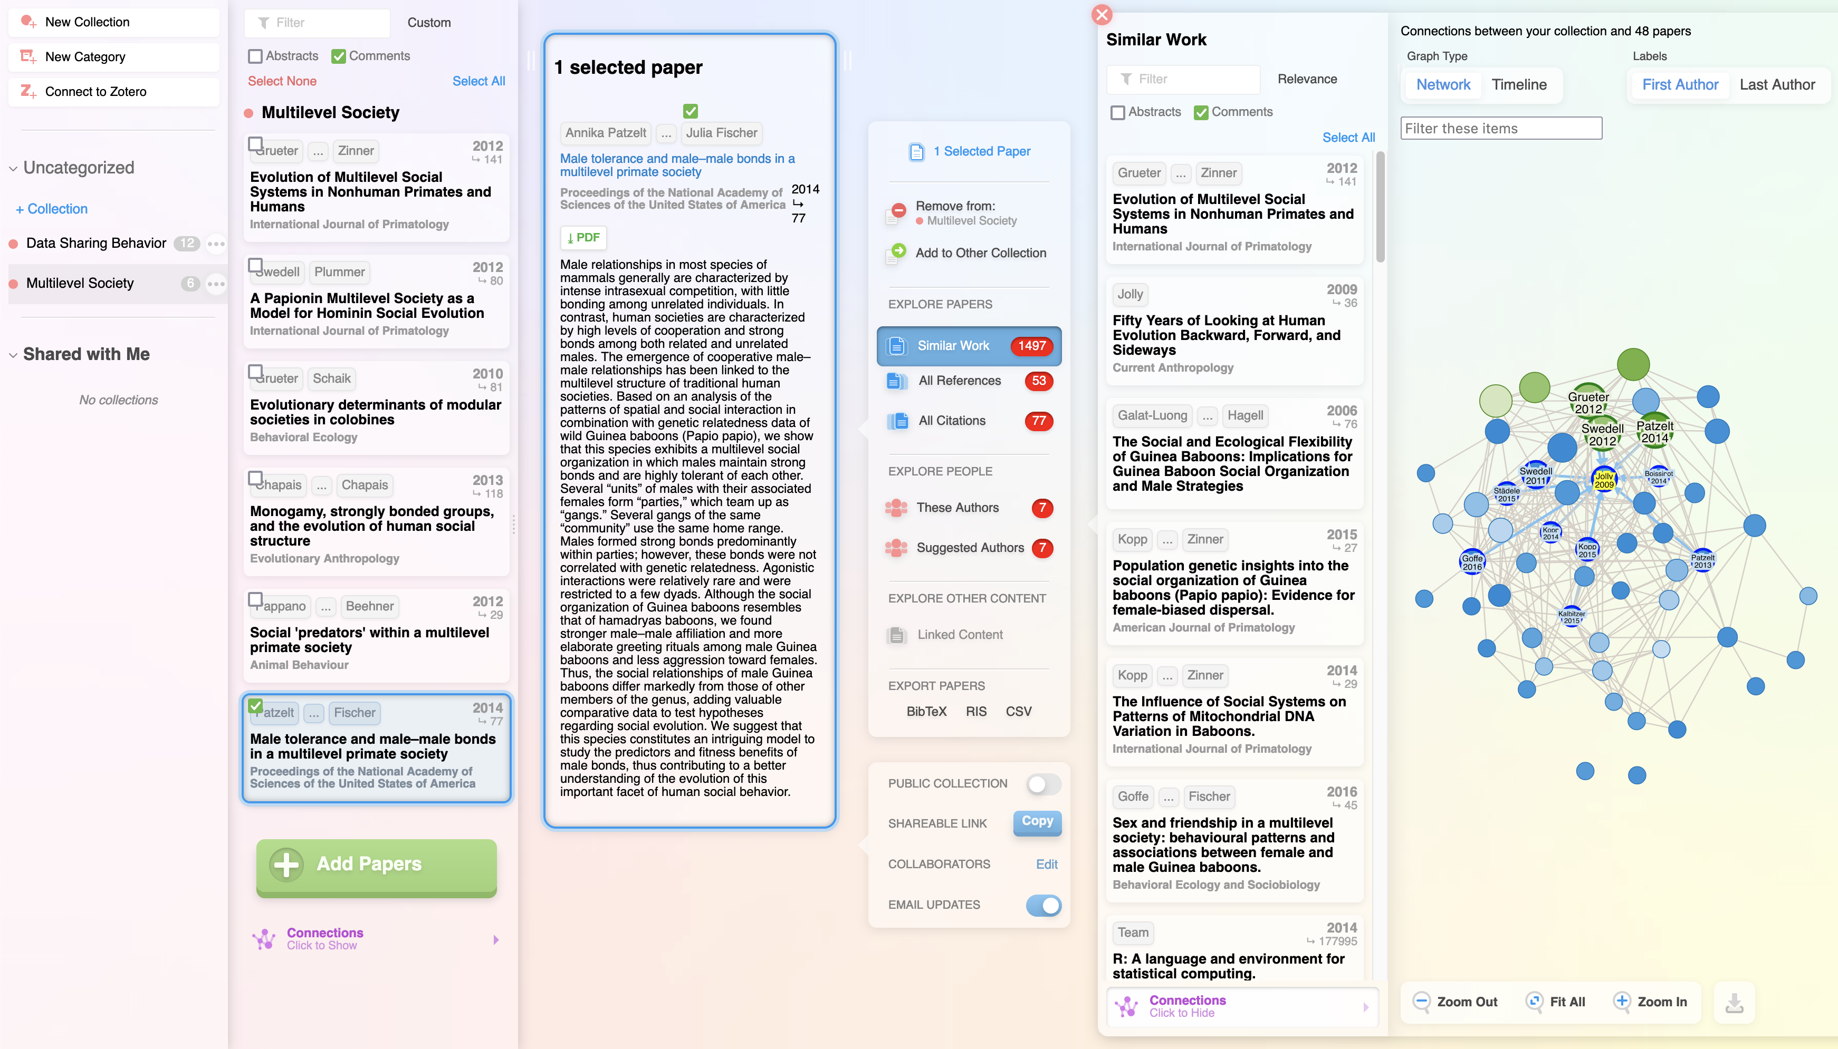
Text-Based Tools
Research Rabbit
researchrabbit.ai

Slide 8
Profile-Based Tools
The “Netflix for papers” model
Primary input is user data
Monitors user behavior
Focused on personalized feeds
May be one component of a larger service

Slide 9
Promise Fulfilled?
Literature-based ML tools could revolutionize interdisciplinary research, but they are not mature.
User profile-based ML tools restrict the focus of researchers to increasingly narrow, specific areas.

Slide 10

ML Misapplied
Machine learning searches for the patterns it is directed to find in the training datasets—“more like this”
Over time and with feedback, the precision increases
Precision does not equal accuracy
“Research identity” is not and should not be unidimensional
"Reflection of the Turning Torso" by Susanne Nilsson, CC-BY-SA 2.0
Notes:
"Reflection of the Turning Torso" by Susanne Nilsson is licensed under CC BY-SA 2.0

Slide 11
Profile Me Please
Why are profile-based services so popular?
  Easy to use
  Free (at least in money)
These services seem to “know you better than you know yourself.” They don’t. It’s one part illusion, one part self-fulfilling prophecy.

Slide 12
Consulting on ML Tools
The landscape of tools is wide and growing rapidly
Ask researchers about their goals
Understand their resources and limiting factors
Encourage them to consider data collection, lock-in risk
Explain the problem with profiling in interdisciplinary work

Slide 13
Other Uses for AI
“Reading” and summarizing papers
Getting a topic overview
Refining existing prose
Generating starter code
Research integrity checks
Want to stay up-to-date on how academics use AI? Dr. Mushtaq Bilal @MushtaqBilalPhD on Twitter

Slide 14
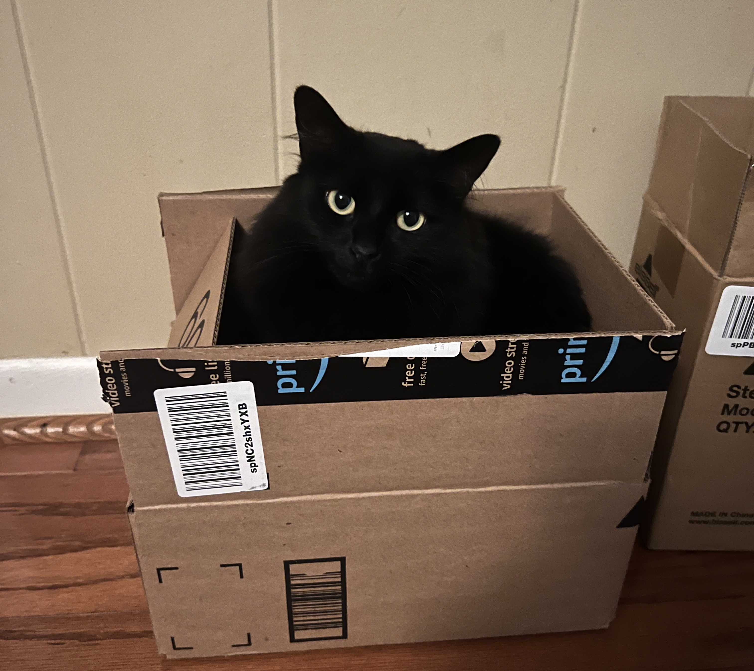
Thanks for Listening!
Ali Krzton, Research Data Management Librarian
alk0043@auburn.edu

