Slide 1
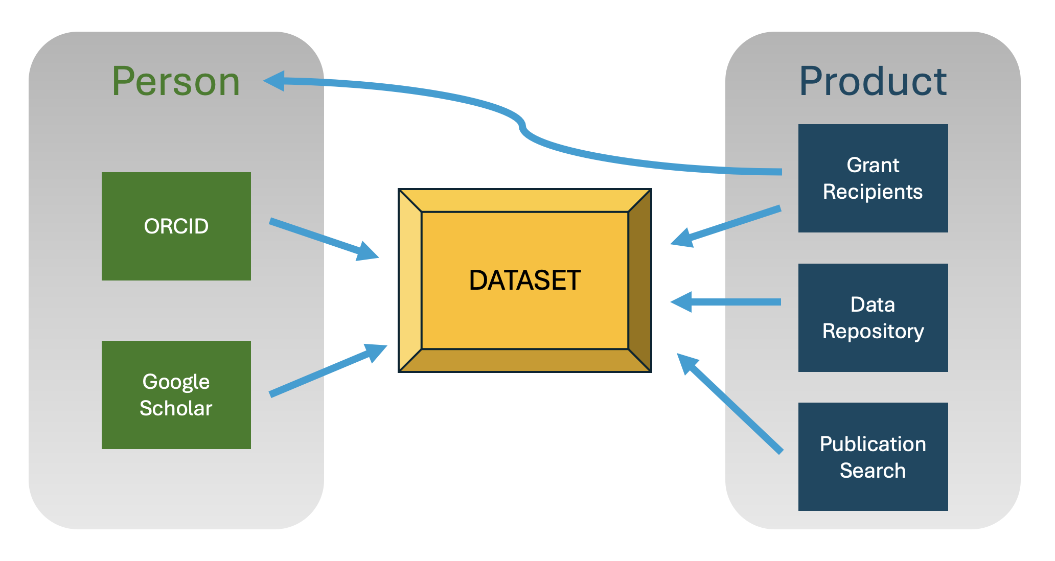
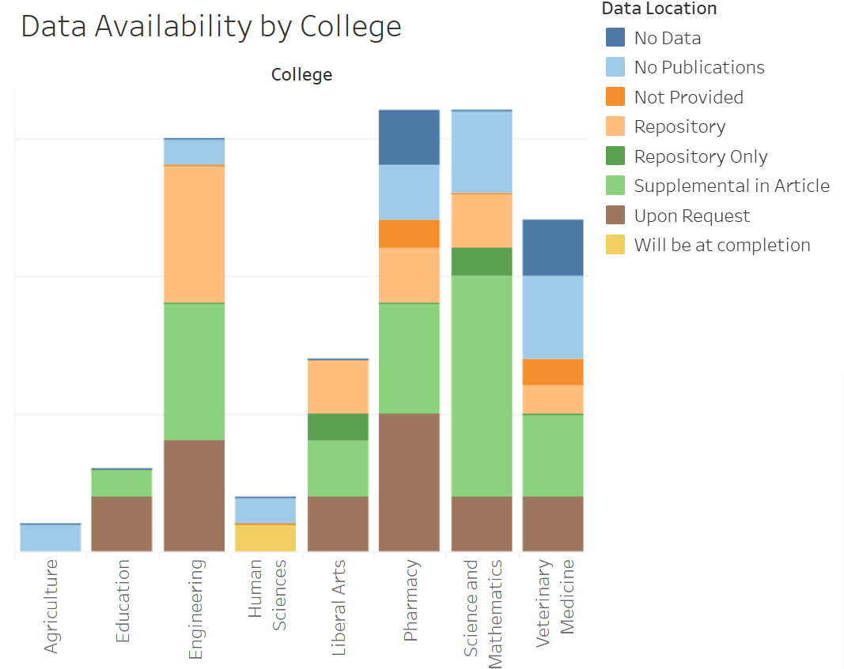
A Multi-strategic Approach to Locating Institutional Data Deposits
Samantha Loster and Ali Krzton
This project aimed to discover open data produced by researchers affiliated with Auburn University. Multiple methods of searching for datasets were compared to discover strengths and weaknesses. Overall, we found extensive searching and manual review will be necessary for projects of this sort.
Results
At the time of this presentation, USDA grant recipient publication search was ongoing, with 131 datasets discovered so far. Previous searches uncovered 55 datasets via NIH grant products, 440 datasets via searches of generalist repositories, and 6 datasets via the Web of Science “associated data” filter.
A notable discovery from reviewing data availability statements is that many papers reporting work funded by federal grants with data sharing policies still specify “Data Available Upon Request.”
Known Issues
Regardless of approach, researcher affiliations lack consistency. While this issue wasn’t tied directly to our research, we noticed that some universities have undergone name changes due to rebranding. This can make connections difficult to find. There is also a gap in uniformity between named research authors, listed grant awardees, and dataset depositors. This can make any discovery strategy laborious. Further, many researchers do not keep their profiles and published CVs up to date. We routinely encountered incomplete ORCID and Google Scholar profiles when attempting to find all of a researcher’s published works.
Final Thoughts
Affiliations listed in research papers, grant awards, and data repositories need to be consistent, at least within each discipline. Without this step, it will always be taxing to connect researchers to authors, investigators, and contributors. Despite the voluntary nature of dataset publishing, repositories need to find better ways to verify all contributors to a dataset. Ultimately, researchers need to be more thorough with the metadata they provide for research articles and datasets.
Background
University administrators have an interest in assessing their institution’s output of publicly shared datasets by affiliated researchers. As one component of research metrics, they can help demonstrate the university’s impact. Researchers receiving grants from many federal agencies are also expected to make their data publicly available as part of the project performance. Thus, following up on the fate of grant-supported data can reveal the extent of compliance with these mandates. Increasingly, university libraries have been assigned responsibility for some aspects of bibliometric tracking, but this has not formally extended to data products. This project was undertaken to shape baseline expectations of how much effort discovering affiliated datasets could entail and refine methodologies for doing so to assist libraries that may want to provide this service.
Workflow
Publication databases were searched with affiliation and “has data” filters
Data repositories were searched by affiliation
Grant awards were searched for related publications and affiliated PIs
ORCID and Google Scholar profiles of affiliated PIs were used to find works
Data availability statements in publications revealed location of data as applicable
Right: Breakdown of NIH funded datasets by college within AU and by location. Part of a larger dashboard available at http://bit.ly/4iphT6P
Acknowledgements: Part of this research was conducted as part of a Data Services Continuing Professional Education (DSCPE) capstone project. We would also like to thank our student assistant, Jesy Heard.

